Slide 1

Cash Receipts
Click to Begin

Slide 2
Error!
Please follow the on-screen
instructions to continue.
Go Back

Slide 3
Complete
Please navigate to the next module
in the course to continue.
Restart Course

Slide 4
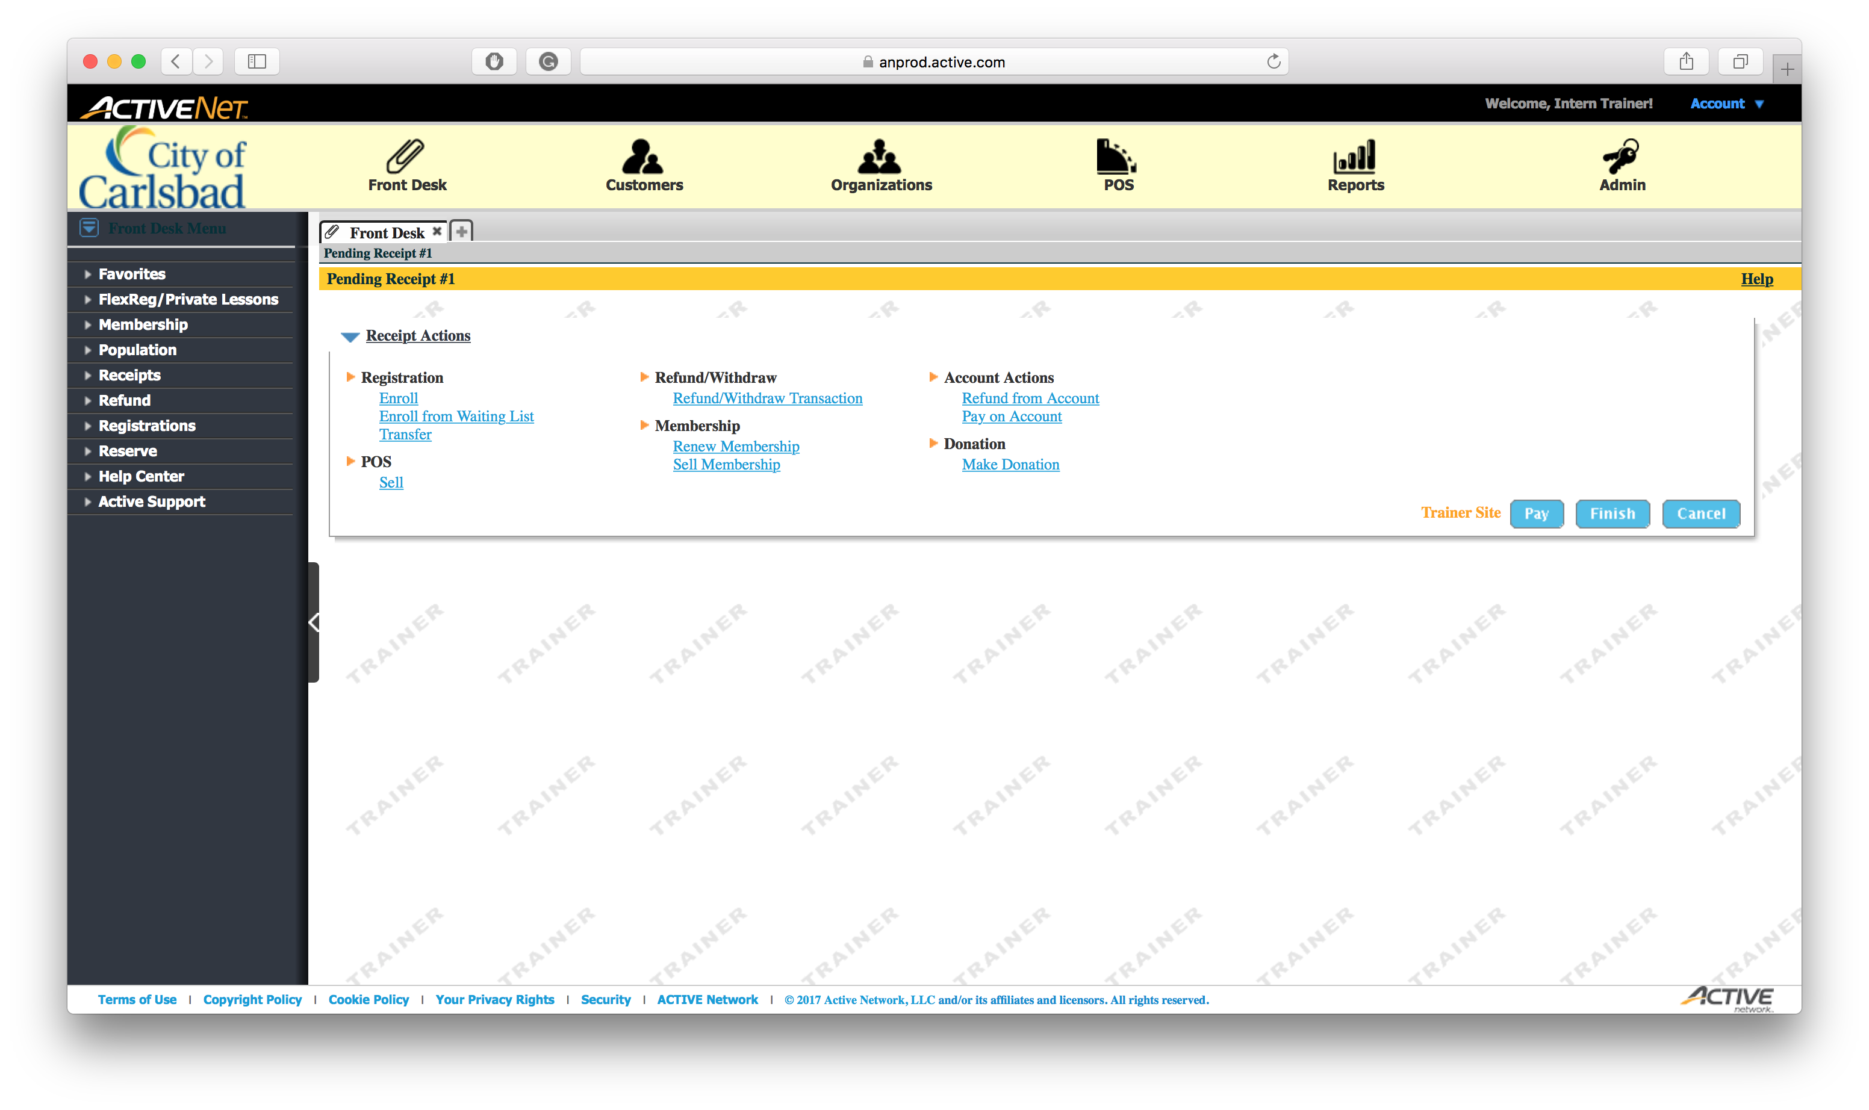
Tip:
Main Text Instruction Will Go Here
Select the Reports module
Sub Instruction Here
This is where we print all reports

Slide 5
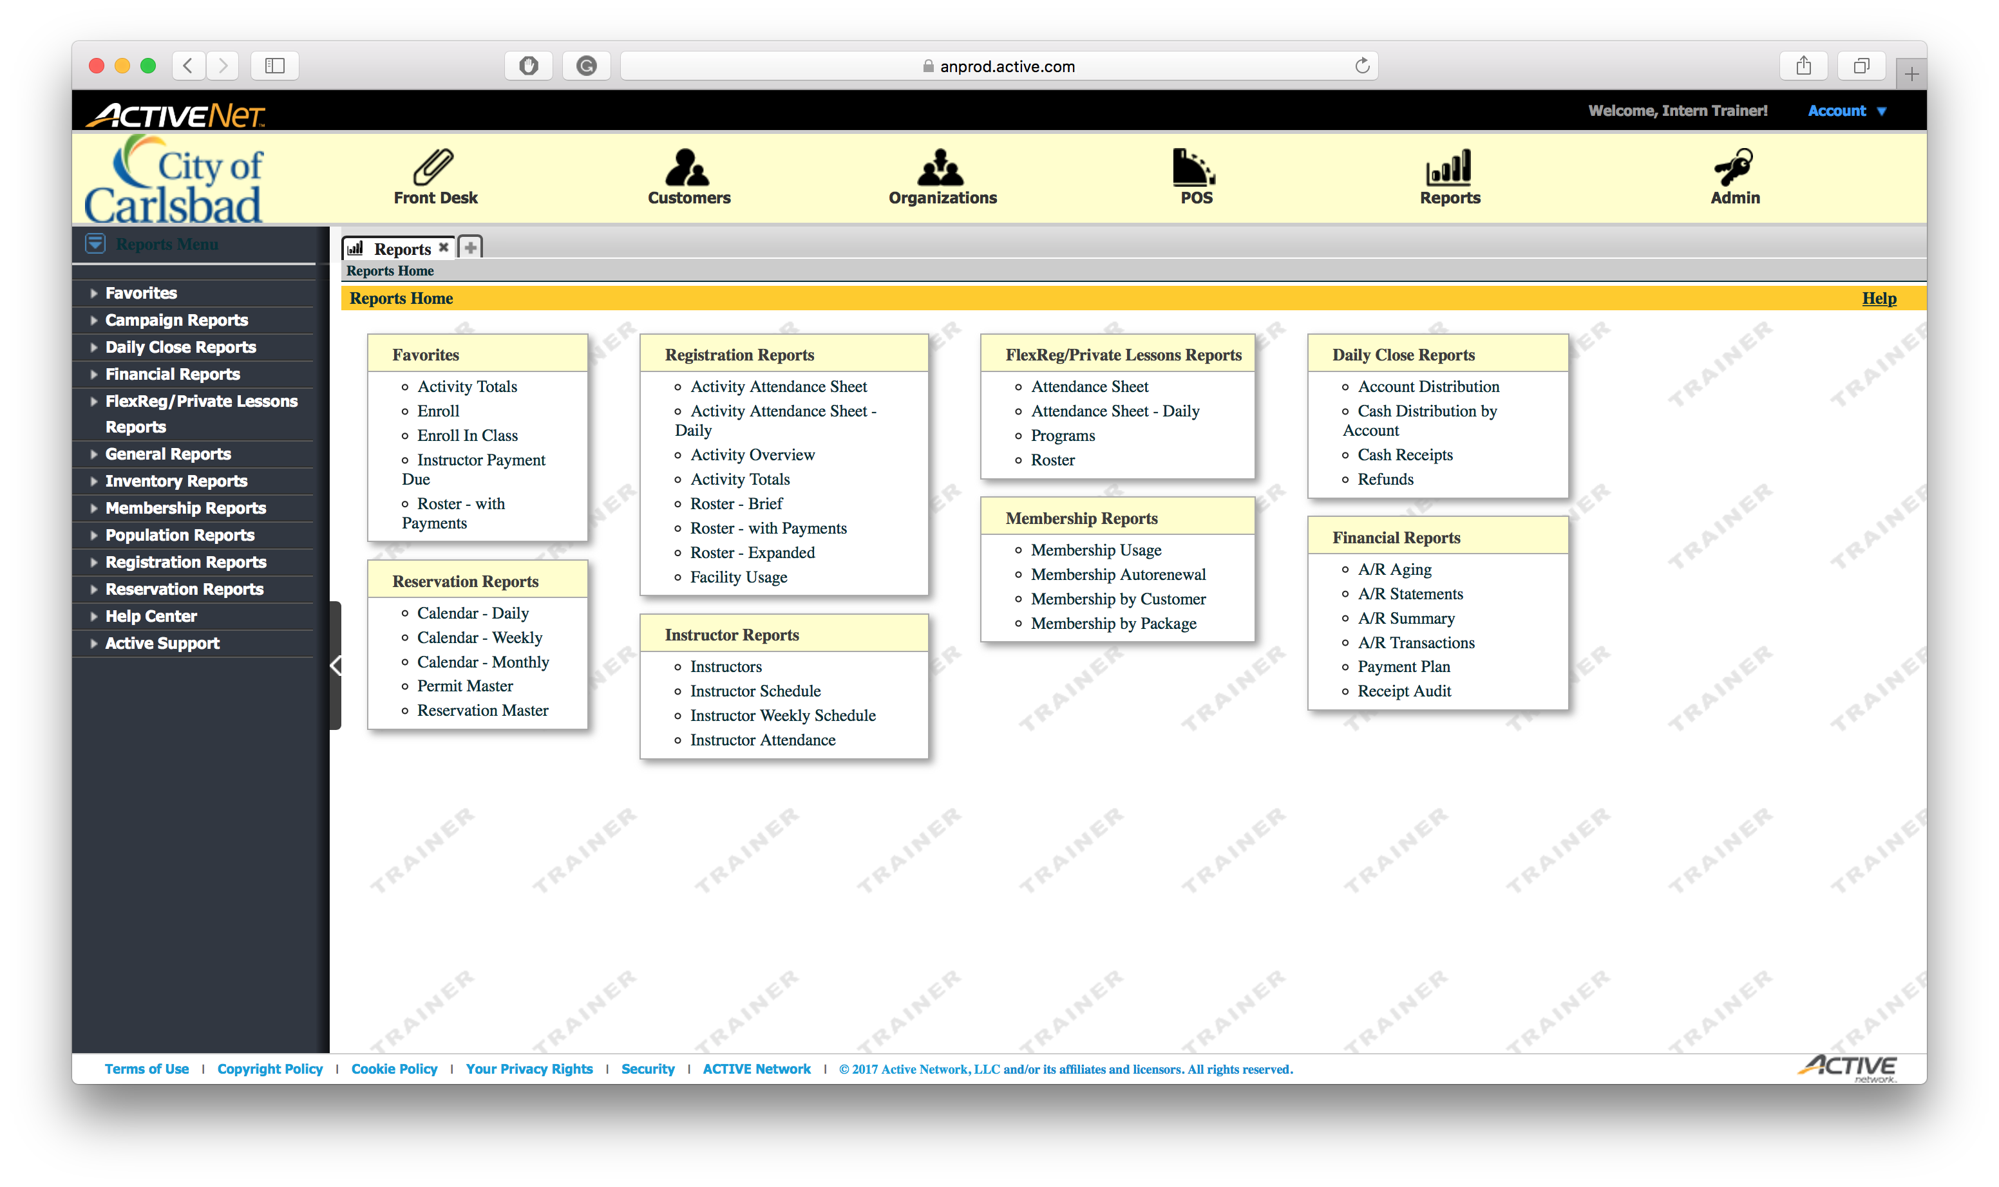
Tip:
Main Text Instruction Will Go Here
Select the Cash Receipts option from the Daily Close Reports section.
Sub Instruction Here

Slide 6
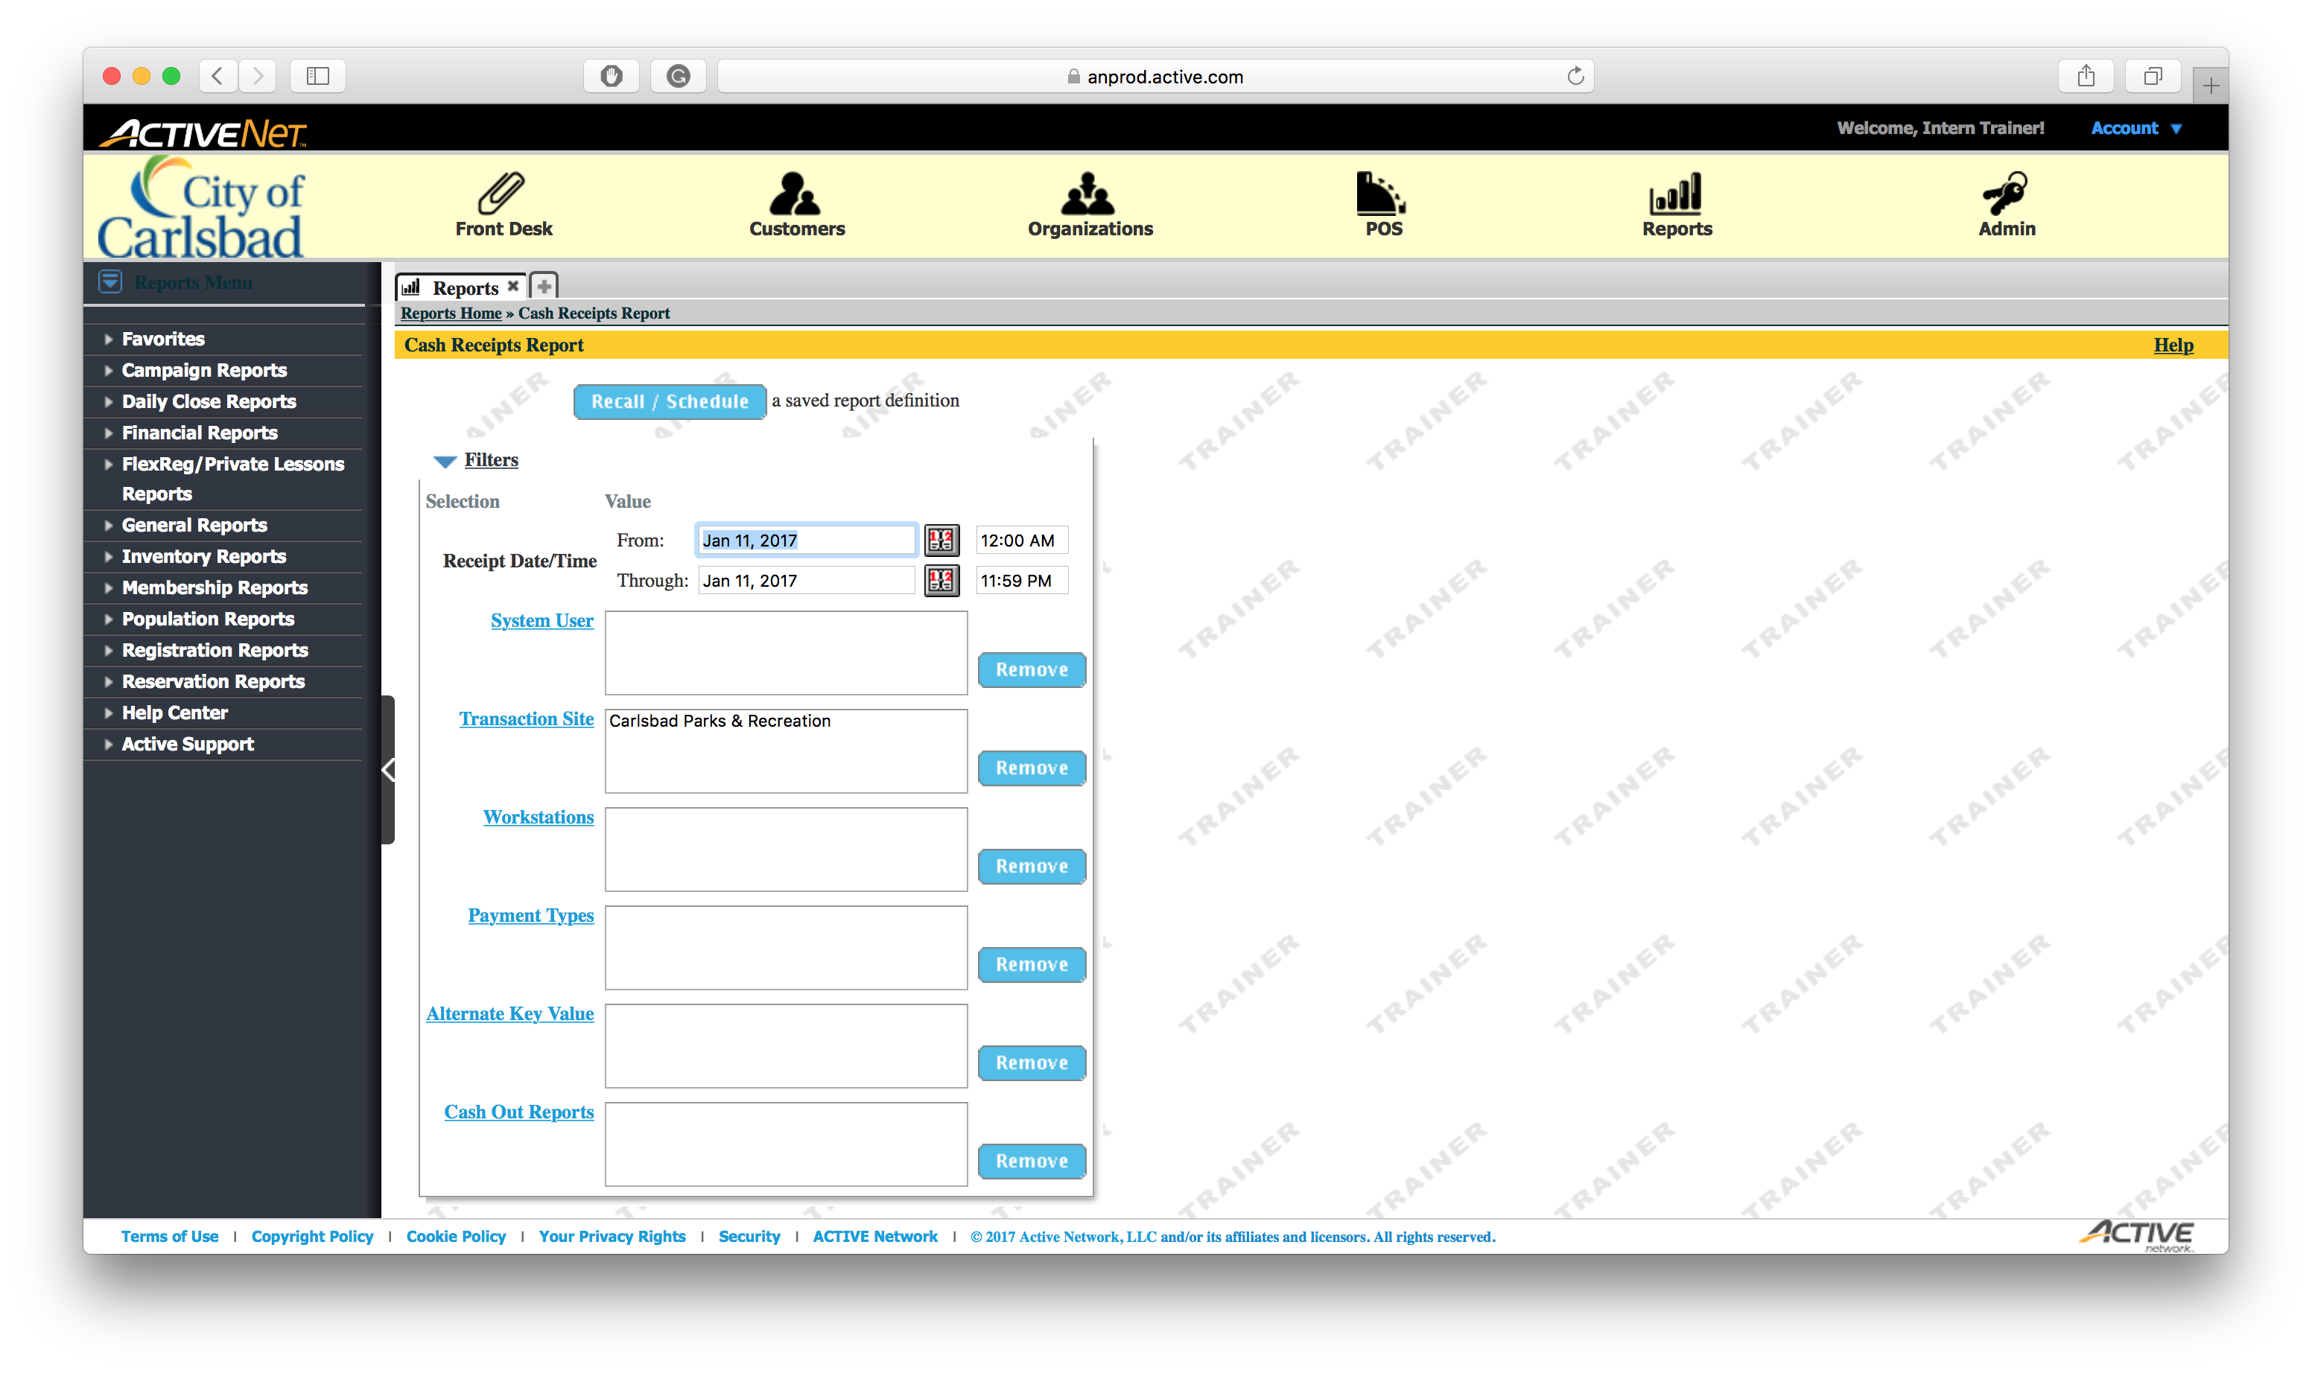
NOTE:
Today’s date is automatically input for you.
Tip:
Main Text Instruction Will Go Here
After verifying the date, select Workstations
Sub Instruction Here

Slide 7
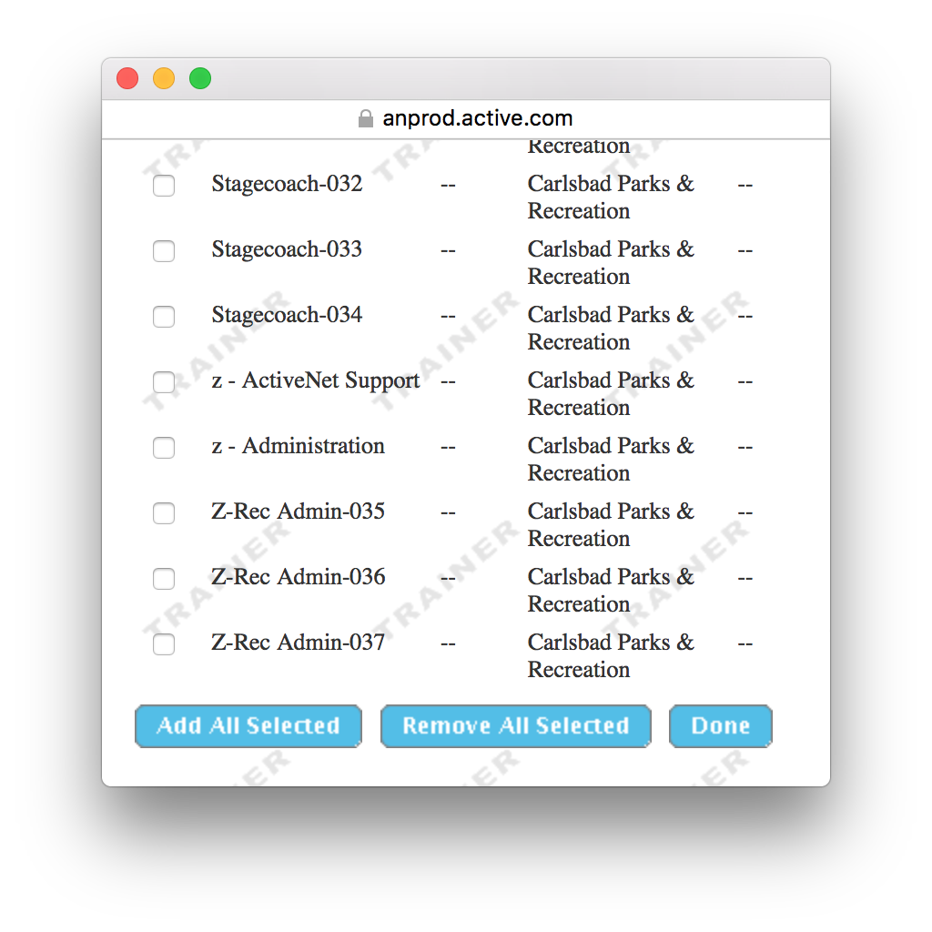
Tip:
Main Text Instruction Will Go Here
Select all workstations for your location.
Sub Instruction Here

Slide 8
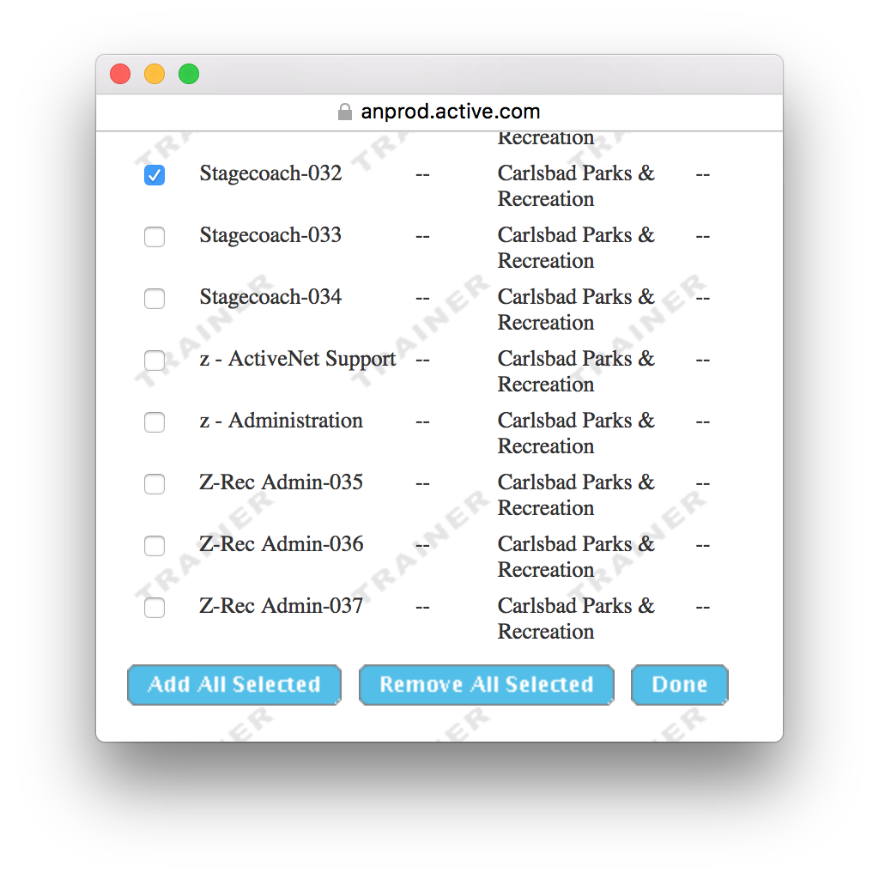
Tip:
Main Text Instruction Will Go Here
Select the next workstation in the list
Sub Instruction Here

Slide 9

Tip:
Main Text Instruction Will Go Here
Select the next workstation in the list
Sub Instruction Here

Slide 10
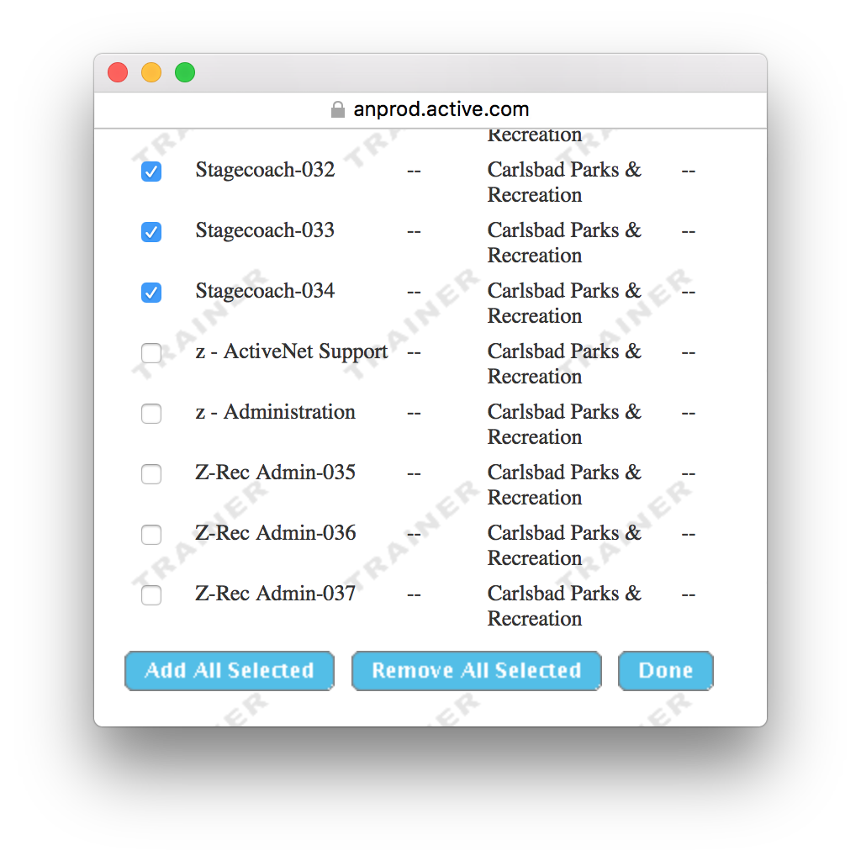
Tip:
Main Text Instruction Will Go Here
Click Done when all are selected
Sub Instruction Here

Slide 11
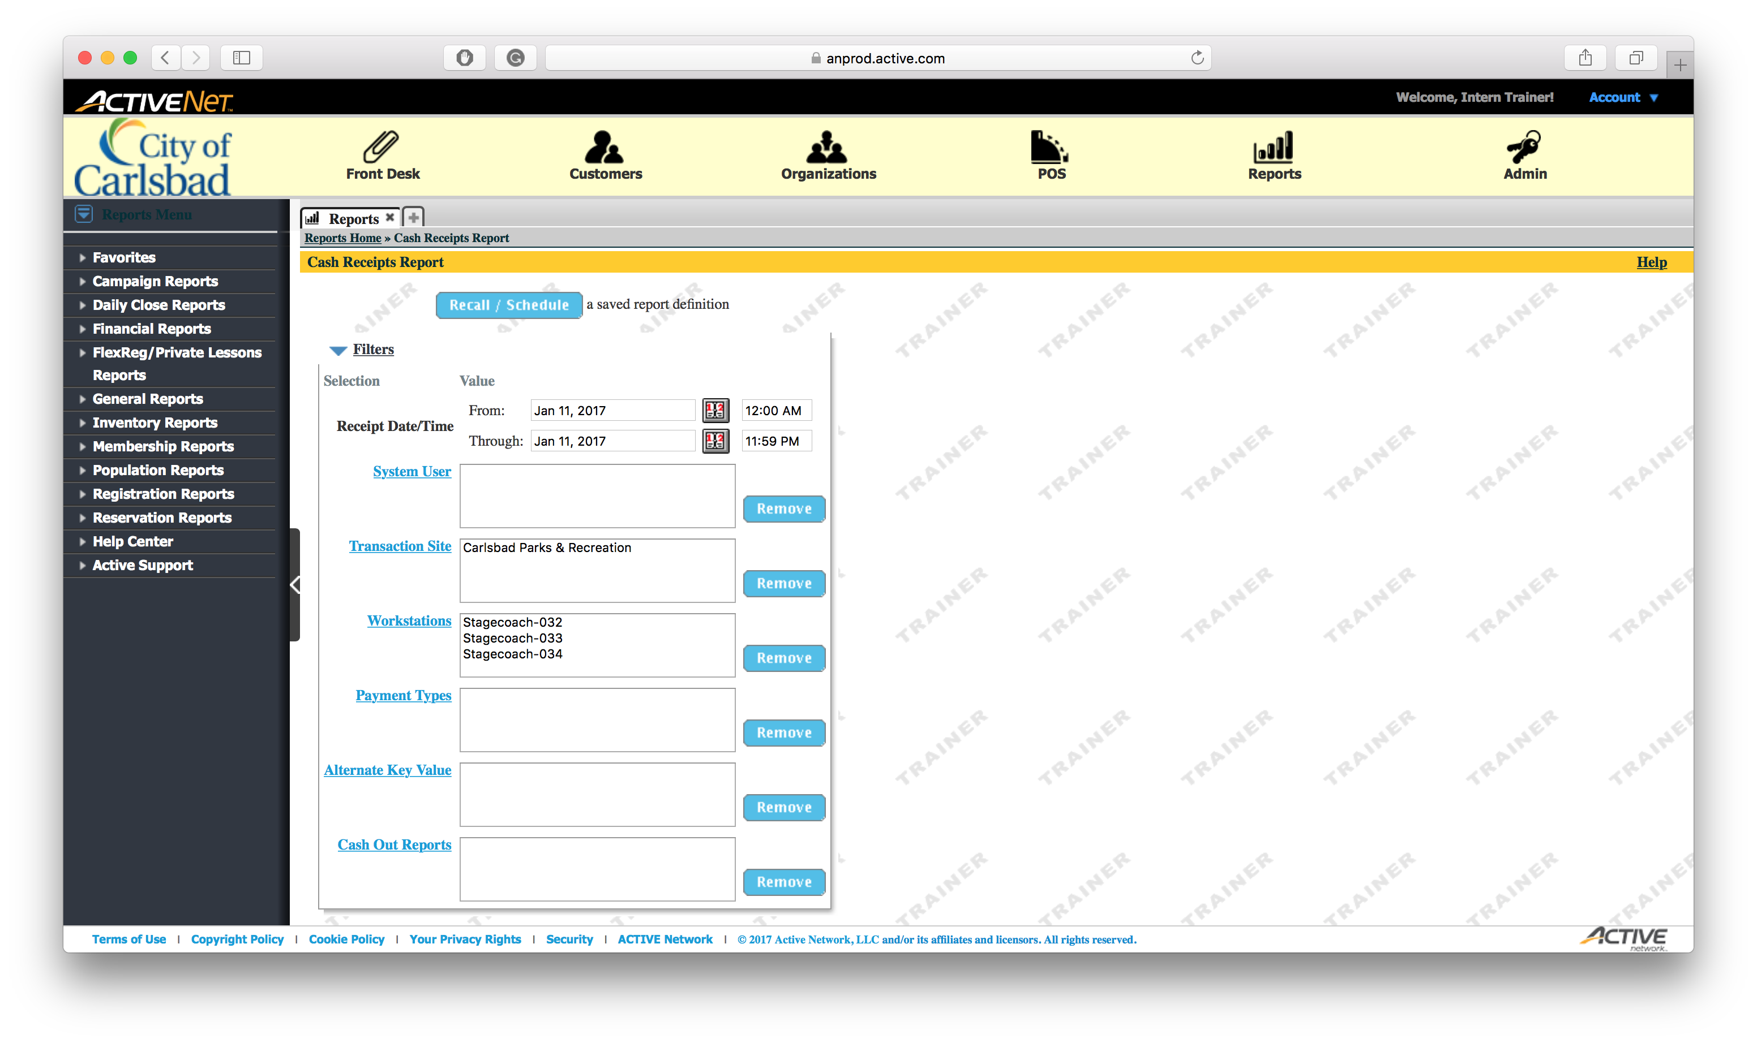
Tip:
Main Text Instruction Will Go Here
Collapse the first table.
Sub Instruction Here

Slide 12
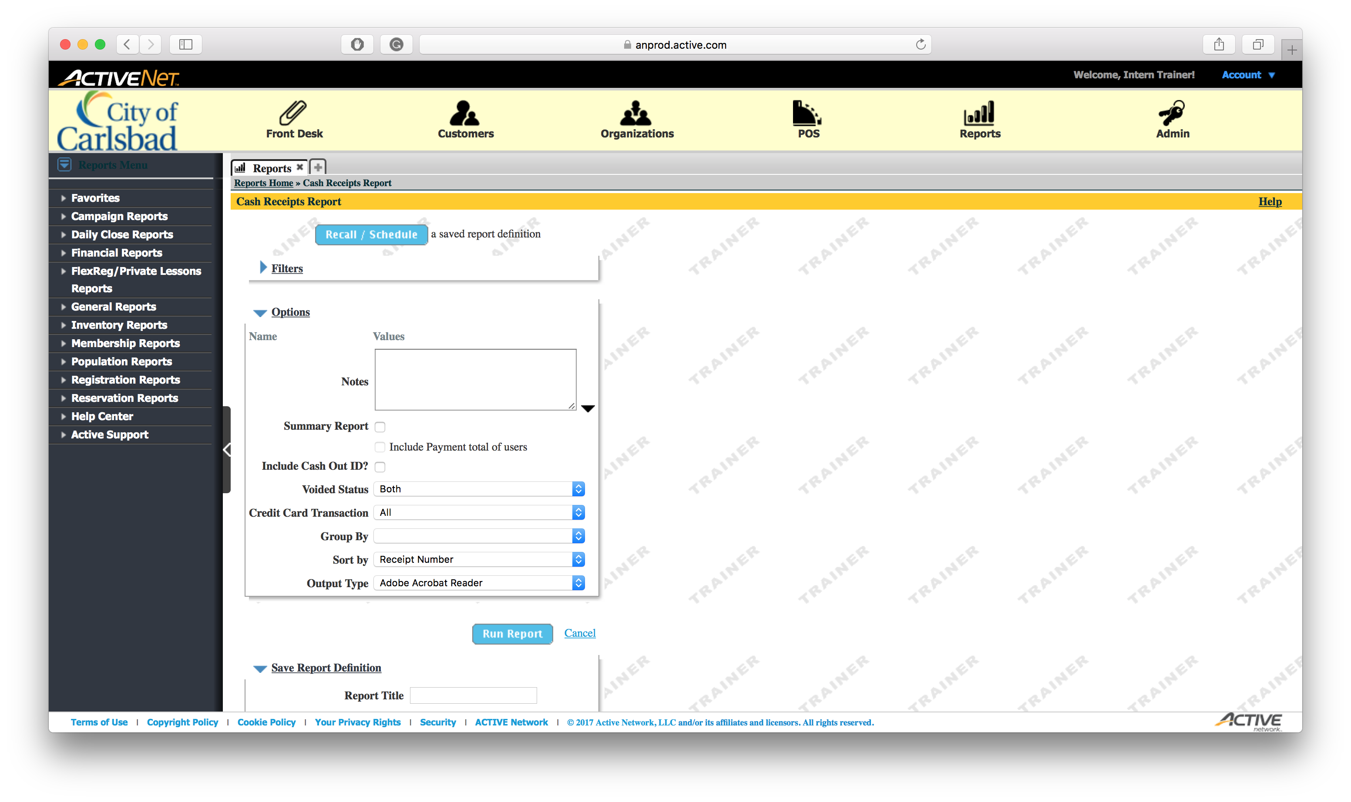
Tip:
Main Text Instruction Will Go Here
Click Summary Report.
Sub Instruction Here
This will only display subtotals and totals – not transaction numbers

Slide 13

Tip:
Main Text Instruction Will Go Here
Run the Summary Report
Sub Instruction Here

Slide 14
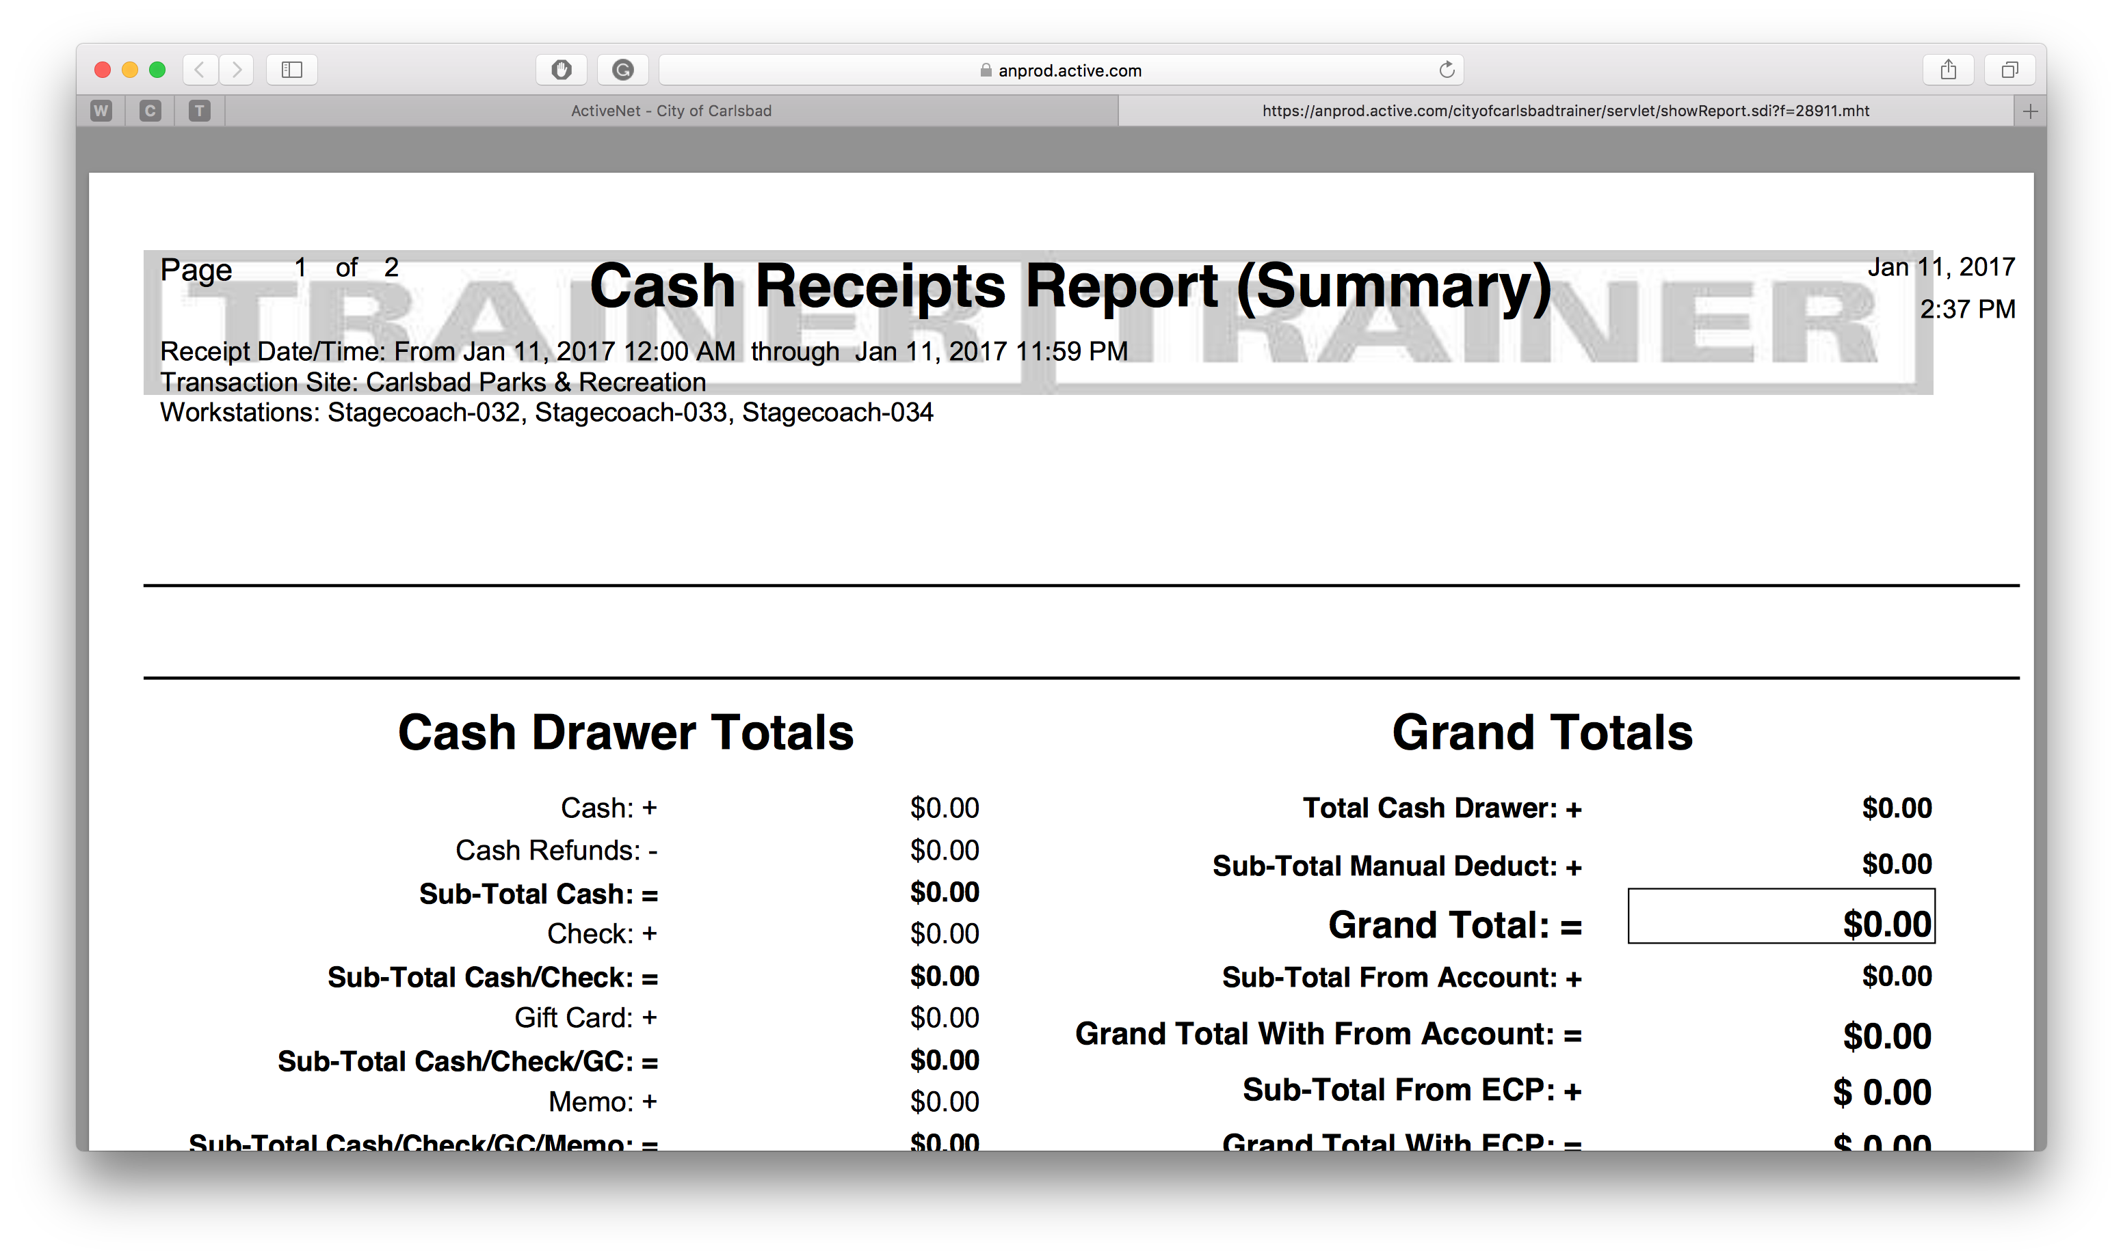
Tip:
Main Text Instruction Will Go Here
This sheet is submitted to Finance
Finish
Part of the Cash Out process includes printing this sheet.
When you are finished reviewing this report, click Finish to move on.
Sub Instruction Here

